Slide 1
Microcontroller Project
Electronic Engineering
Wiktor, Vytaras, HermaNn, Alexander, Pina

Slide 2
Contents
Building
Arduino
Line Tracking
Ultrasonic Sensors
RaspberryPi
Berkeley Socket
Camera
QT

Slide 3
Building – Wooden ELE-Bot Kit
Wooden Panels + Bolts
LiPO (11.1V , 3200mAh)
DC-Motor
Arduino UNO + Motorshield
Line Tracking Sensor
Ultrasonic Sensor
RaspberryPi + L298 Motor Board
Raspberry Pi Camera v.2
USB-Powerblock (5V, 5200 mAh)

Slide 4
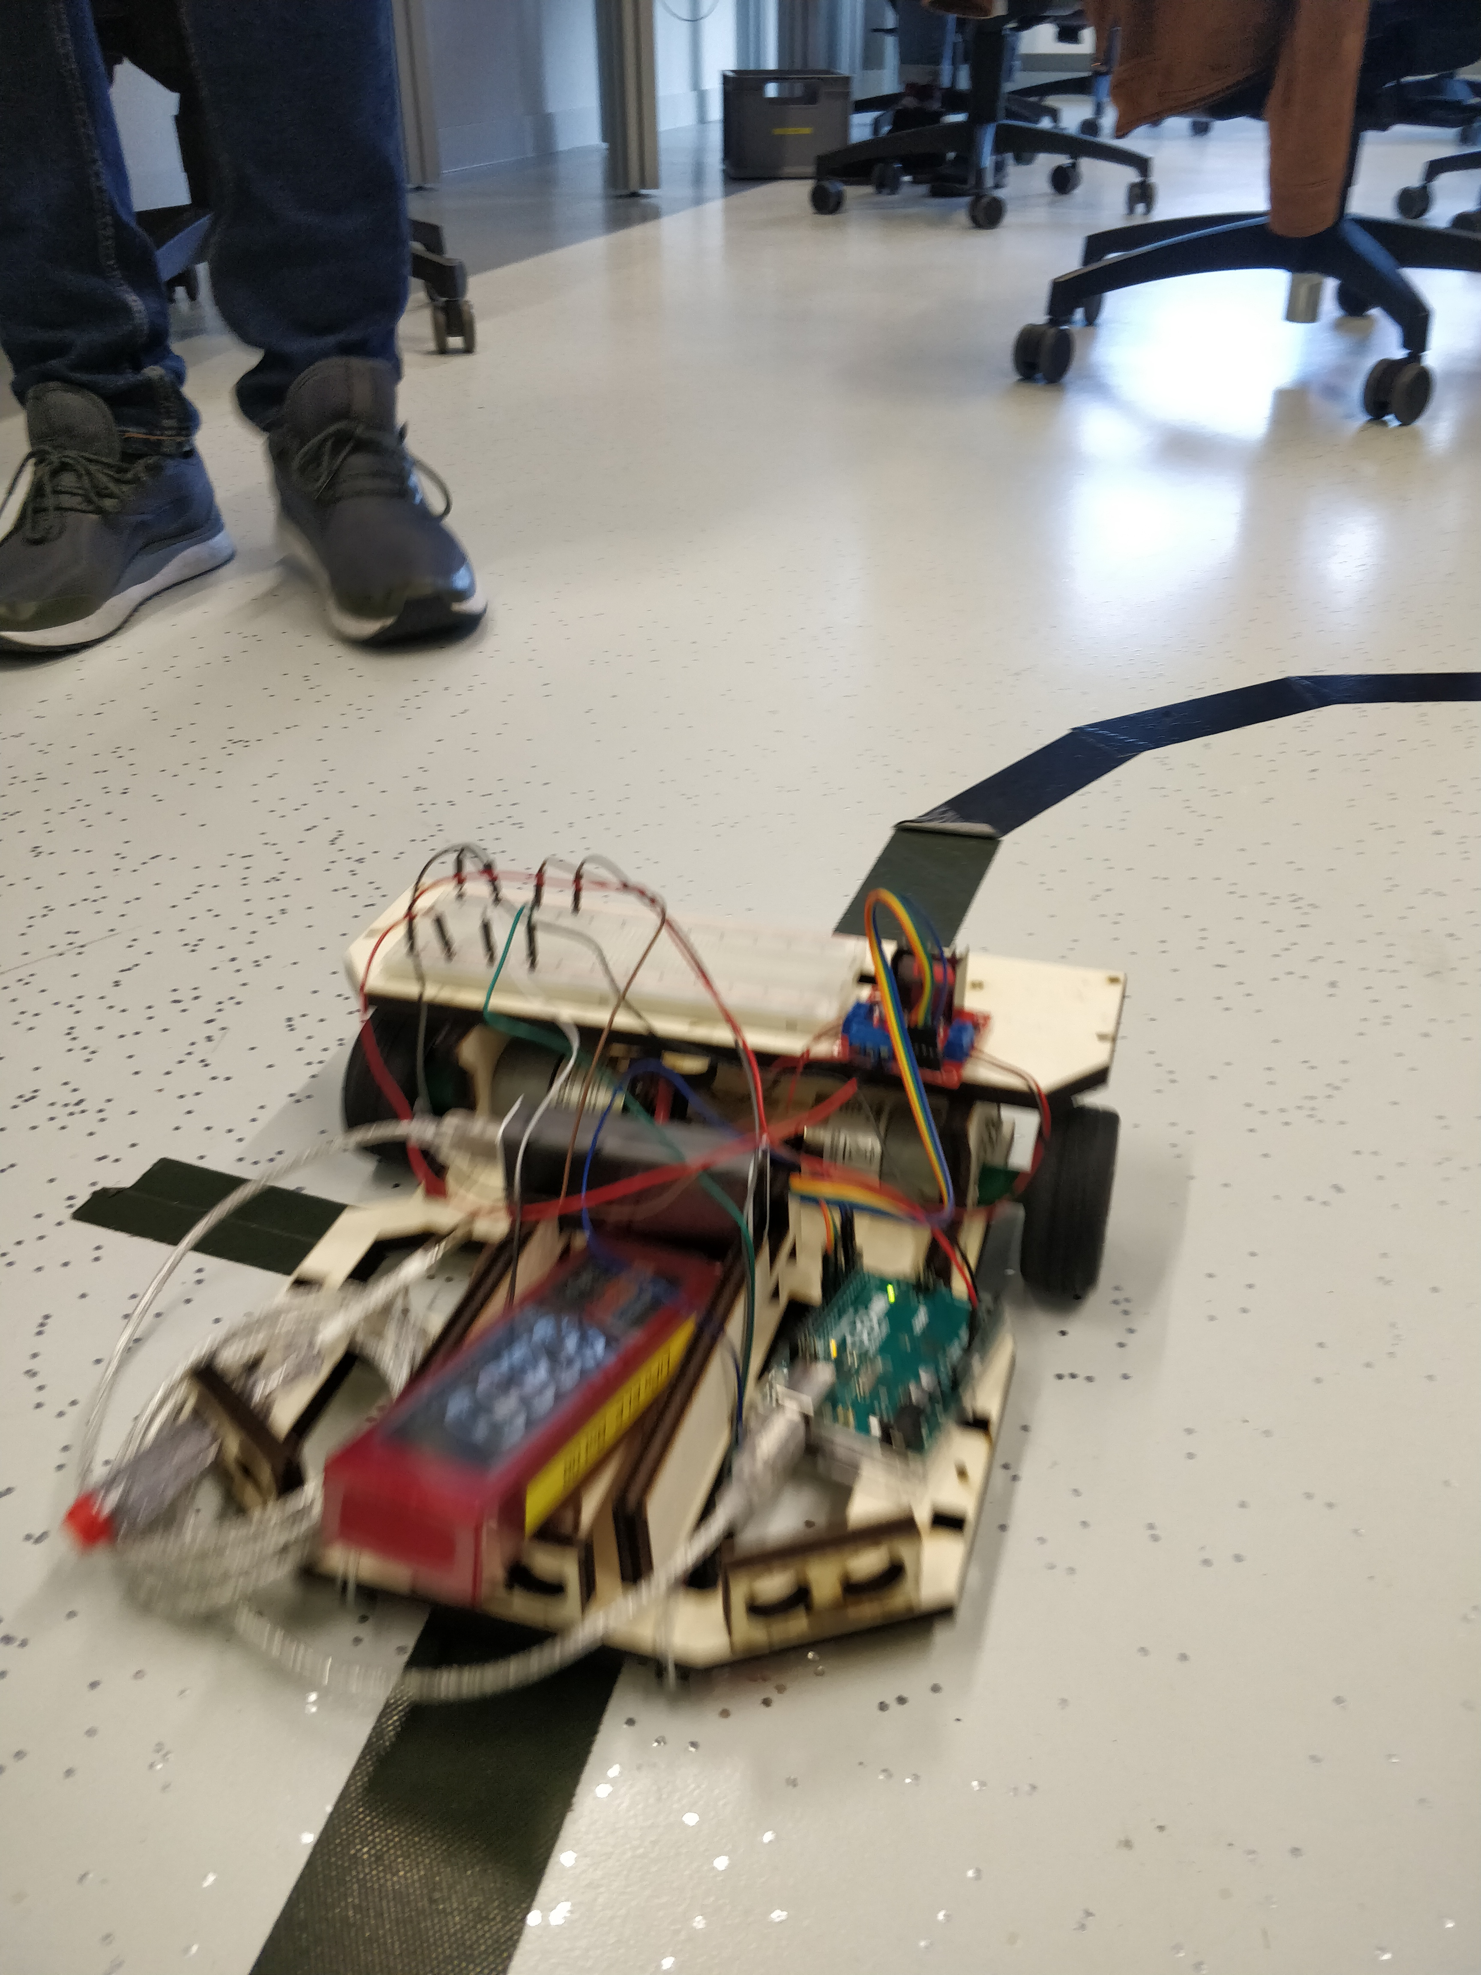
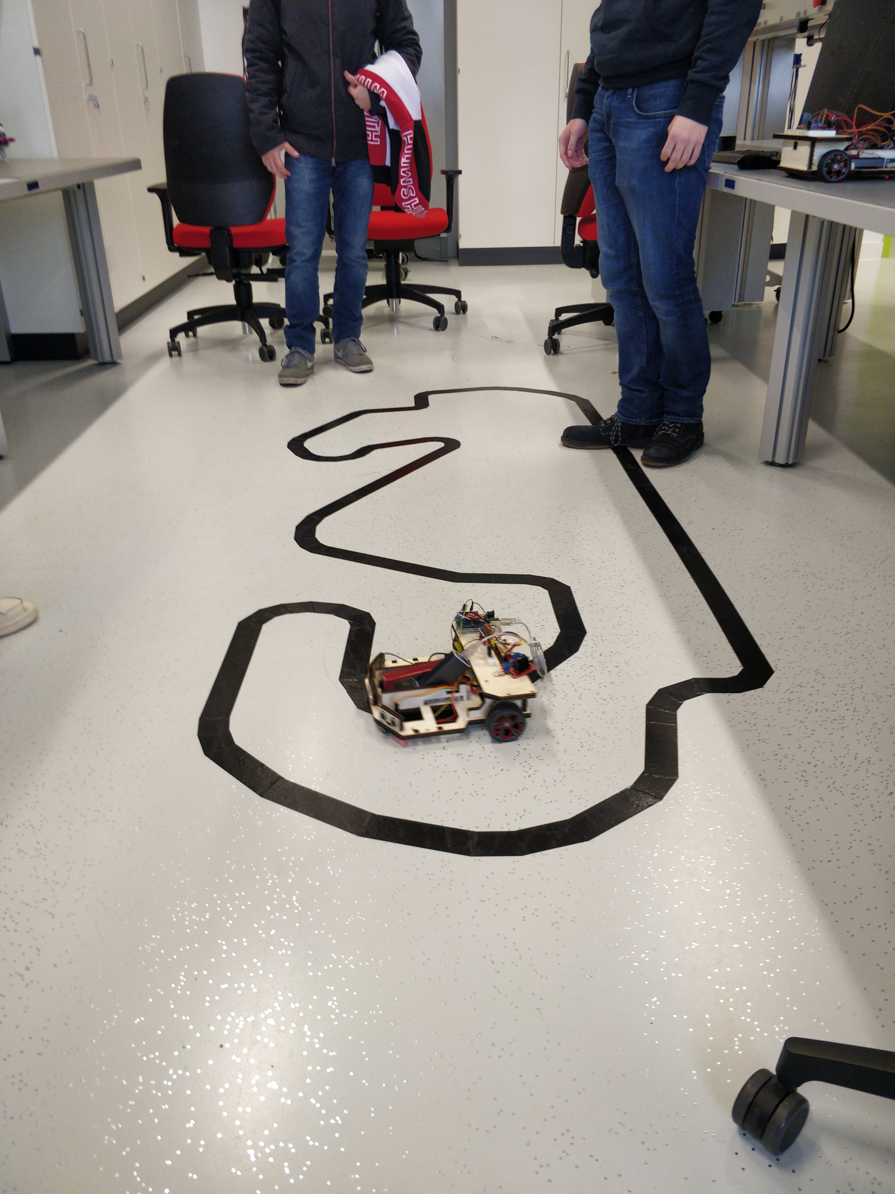
Testing phase

Slide 5
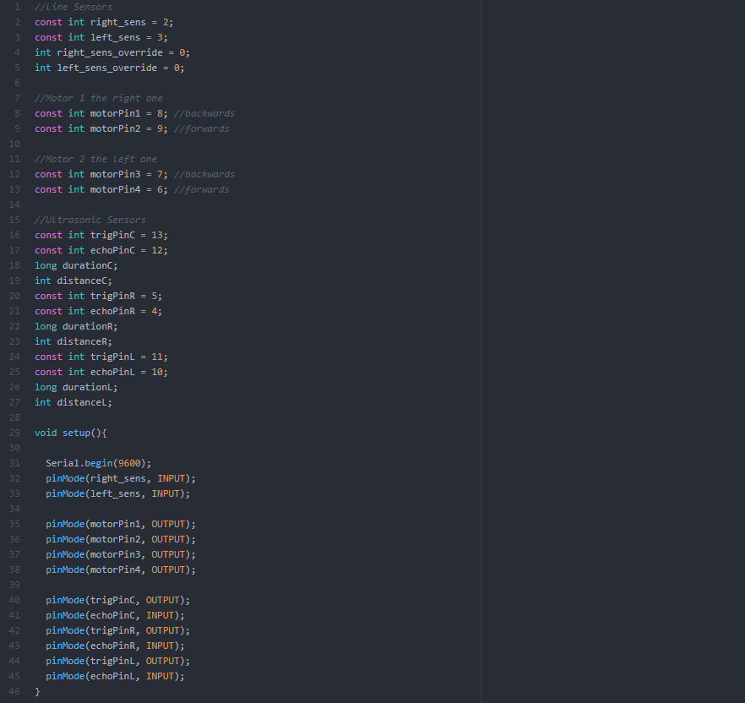
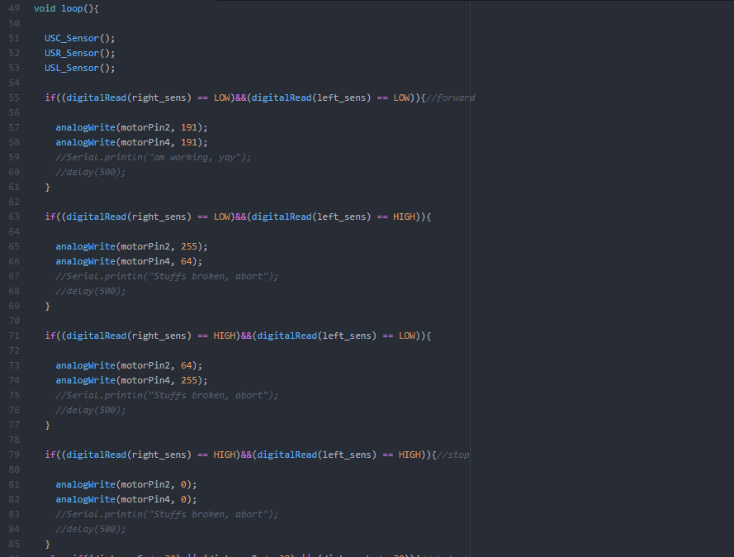
Arduino Setup + InfraRed

Slide 6
Infrared
2 Infrared Sensors
Black Line is in between
If one sensor gets on the line it turns in this direction

Slide 7
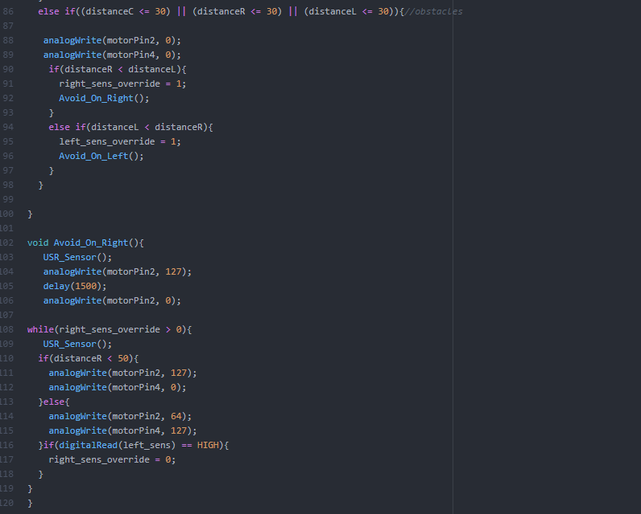
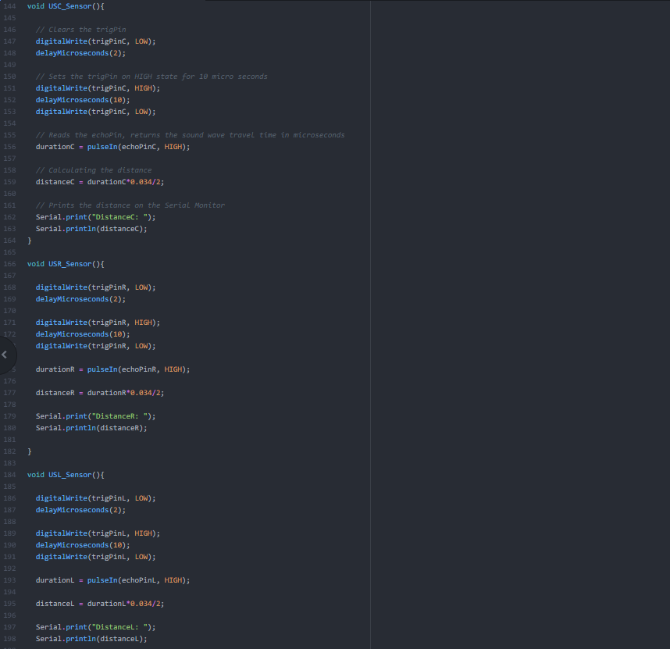
Ultrasonic + Avoidance

Slide 8
Ultrasonic
3 Ultrasonic Sensors
30cm to detect obstacle
While avoiding: If it senses obstacles within < 50cm it turns away
Car drives a curve around it
Car can avoid on either left or right side
When it detects Black line while avoiding it starts following again

Slide 9
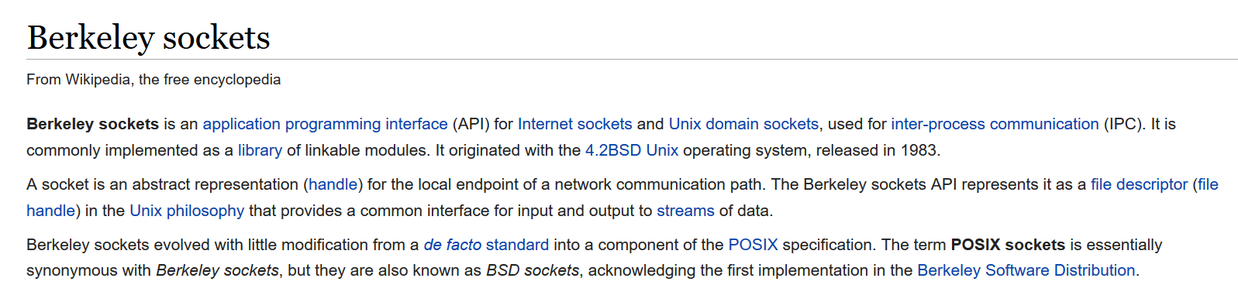
Berkeley Socket
TCP Socket API
General Setup for Server and Client
Common interface for input and output to streams of data
Since 1983
Official Code examples on Wikipedia to include in your projects

Slide 10
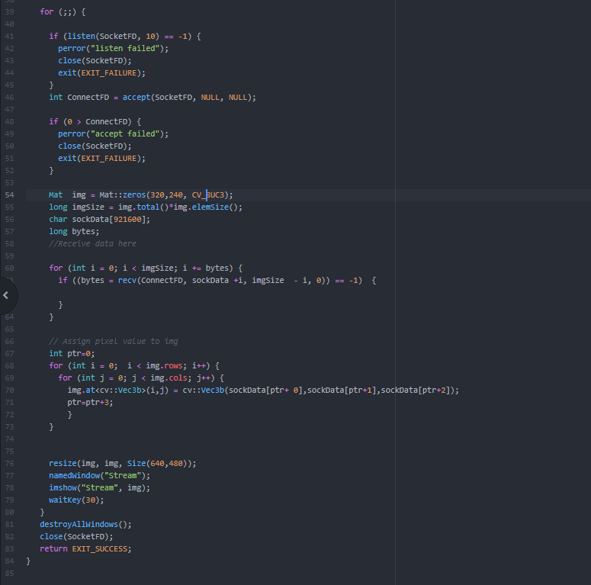
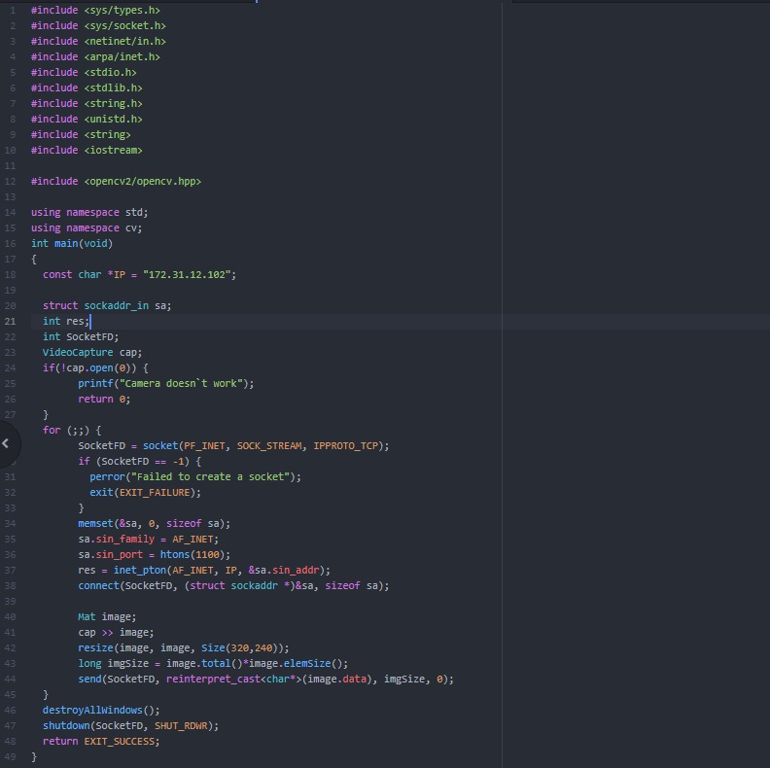
RaspiCam Stream
Client side
Reduce resolution to 200x200
Put into byte stream
Convert bytes to characters
Send the characters
Server side
Receive characters
Convert characters to byte stream
Map the characters to Matrix
RGB values
Construct Image 640x480

Slide 11
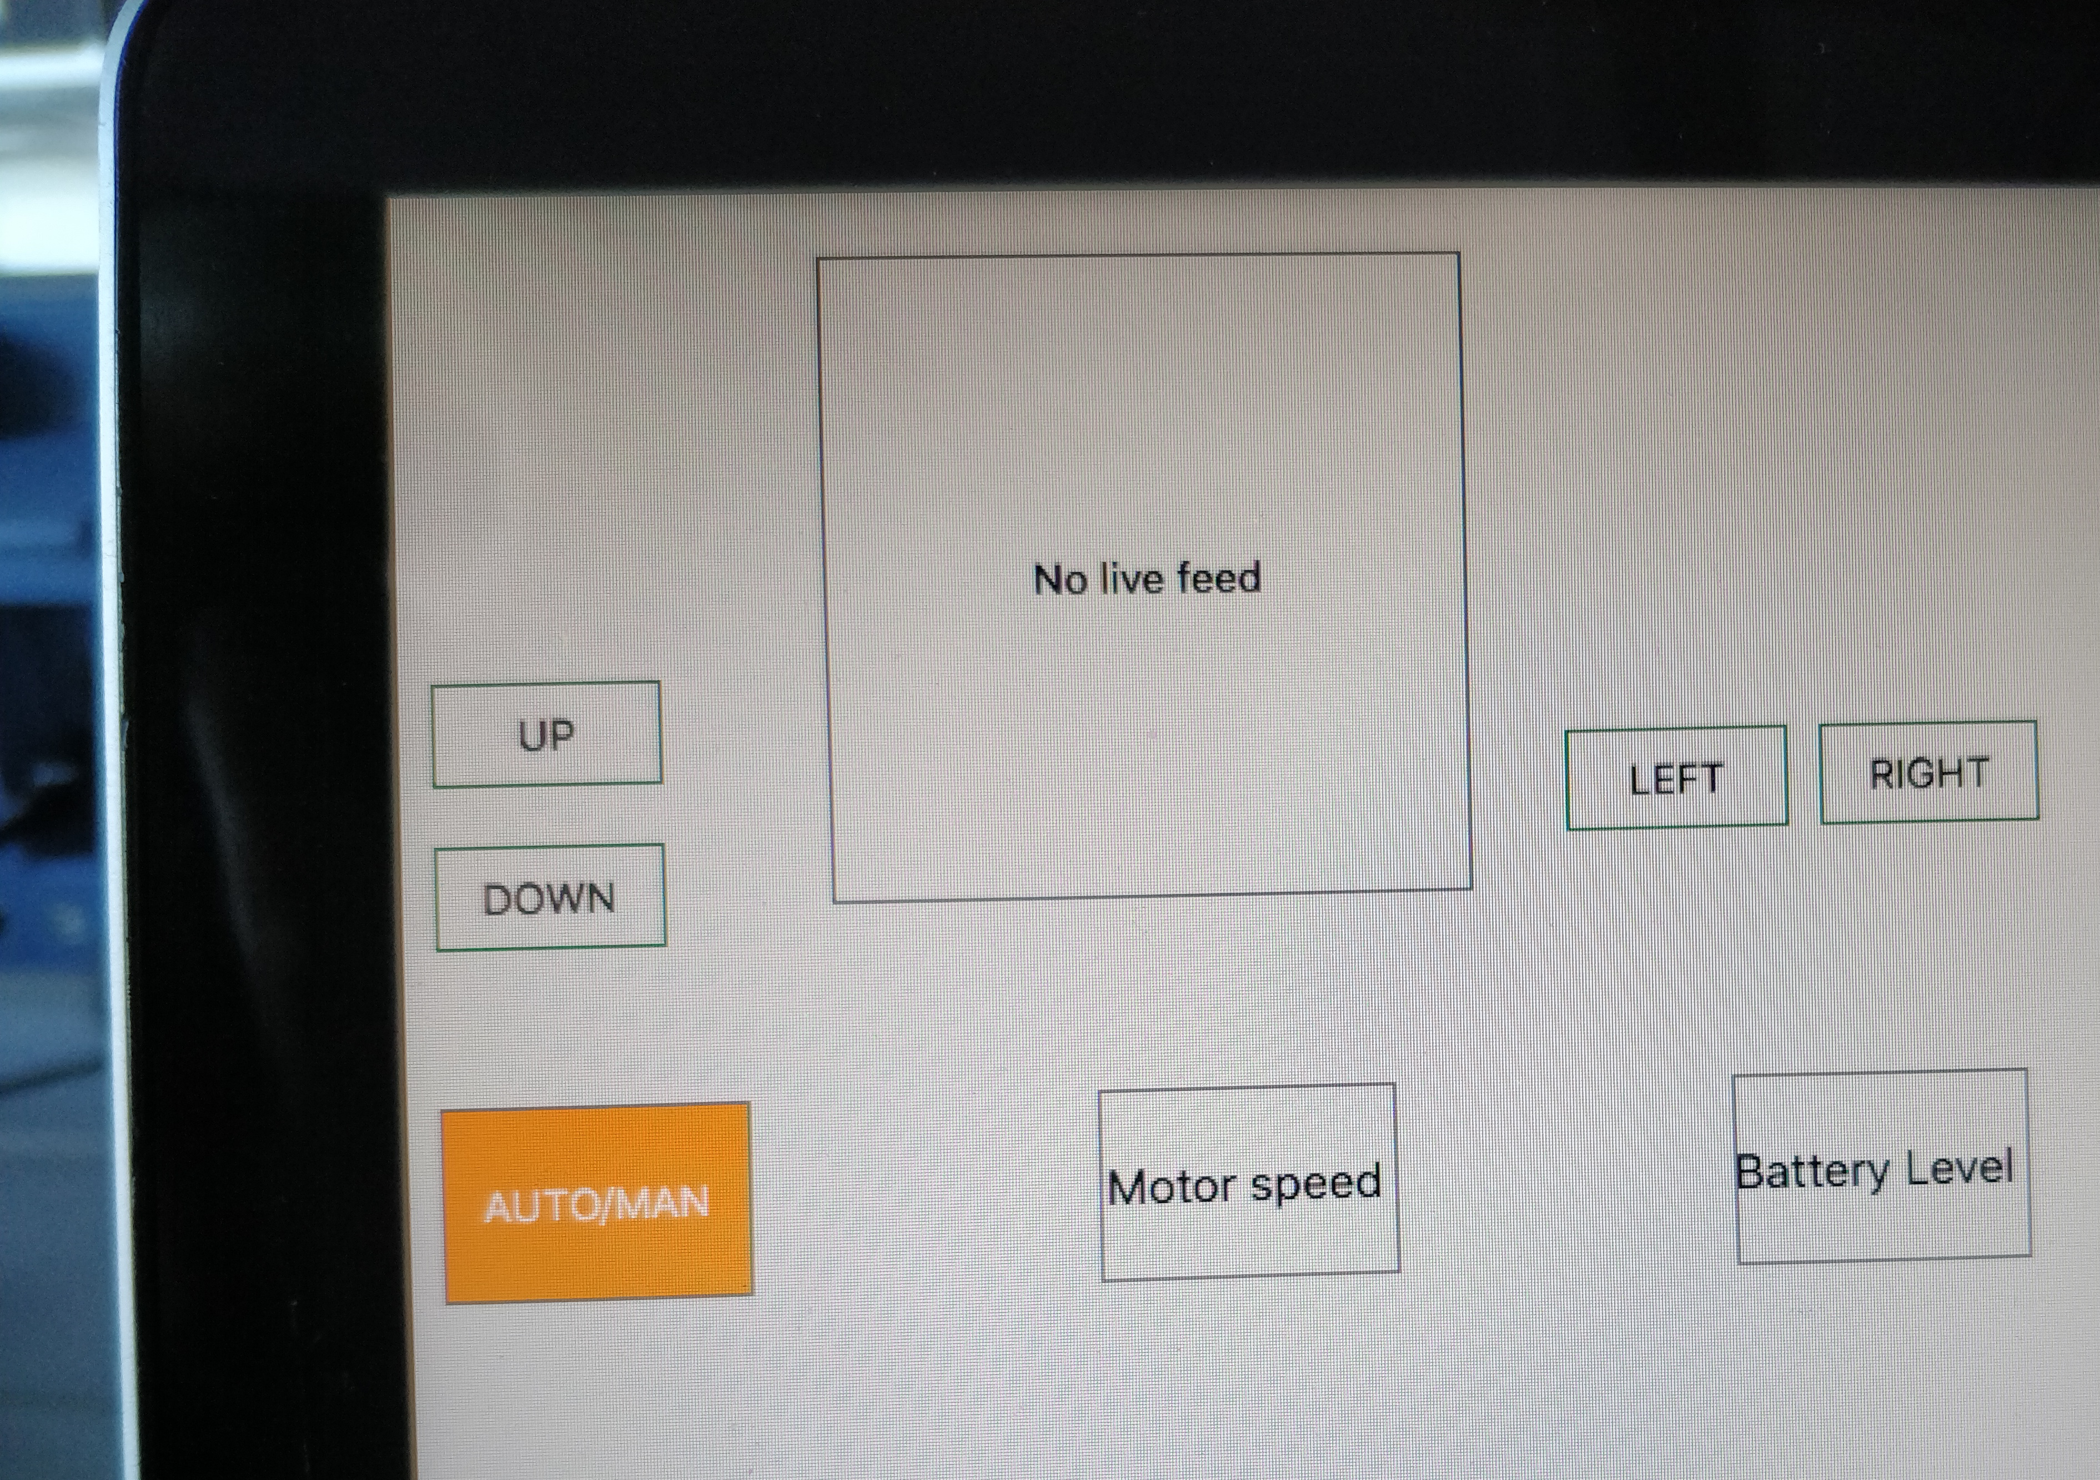
QT

